Slide 1



Slide 2
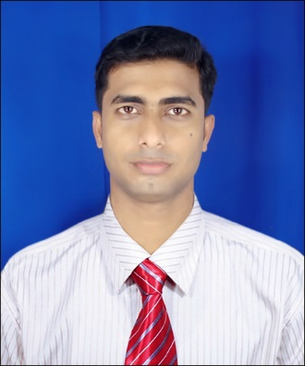
Teacher’s Introduction
Anowarul Kadir Shohag
Asst. Teacher(English)
Foylahat Kamal Uddin High school,
Rampal,Bagerhat.
Contact No. 01712-686816
        01919-686816
        01812-686816
        E-mail: shohagfoyla@gmail.com

Slide 3
Lesson Introduction
Subject: English
Class: Eight
Unit: Three
Lesson: Six
Time: 50 Minutes
Physical Exercise

Slide 4
Learning Outcomes
By the end of the lesson:
* The students will be able to tell about physical exercise,
* The students will be able to tell about the classification of exercise,
* The students will be able to do various kinds of physical exercise,
* The students will be able to describe the importance of physical exercise.

Slide 5
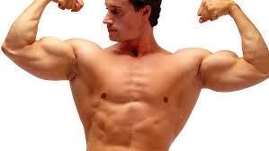
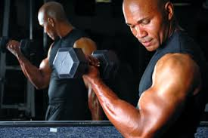
Good Health

Slide 6
What things are necessary for good health ?

Slide 7

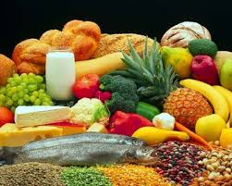
Good Food

Slide 8
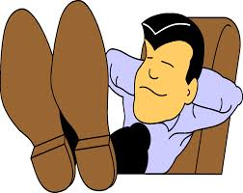
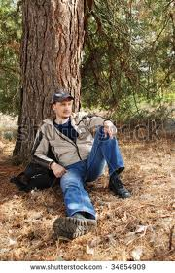
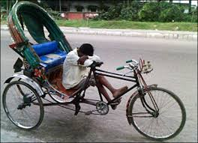
Proper Rest

Slide 9
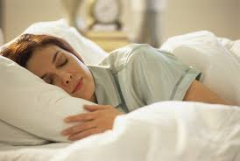
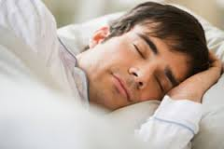
Sleep

Slide 10
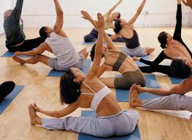
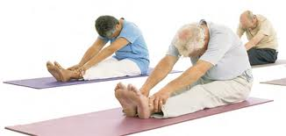
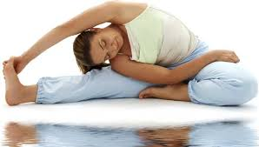
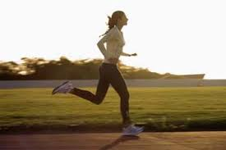
PHYSICAL EXERCISE

Slide 11
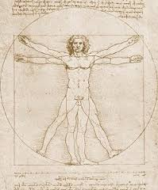
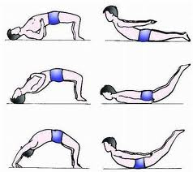
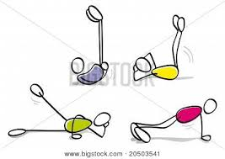
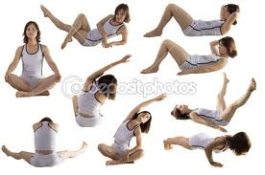
Look at the pictures below:
Can you tell me what are they doing?

Slide 12
PHYSICAL EXERCISE

Slide 13
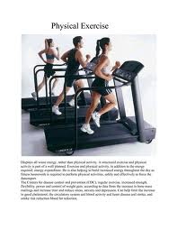
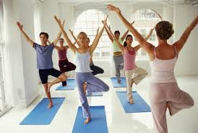
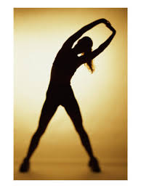
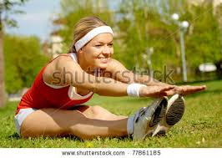

Slide 14
Types Of Physical Exercise
How many kinds of physical exercise?
Indoors
Outdoors

Slide 15
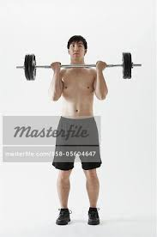
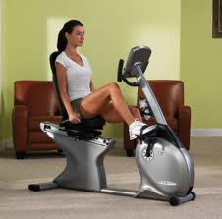
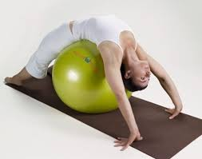
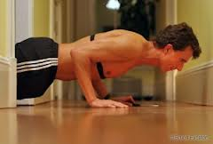
I
N
D
O
O
R
S

Slide 16
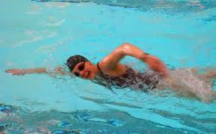
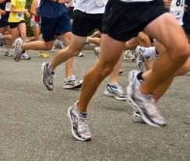
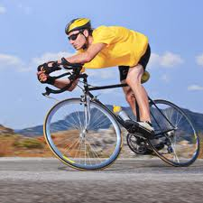
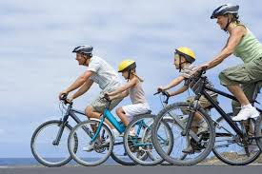
OUTDOORS

Slide 17

Lets enjoy a video clip

Slide 18
Read the text :
Mr Pronay Larma, the physical teacher of Rooppur High School is talking about health to his students. "What things are necessary for good health?" he asks the students. "We need a lot of things, teacher," says Rushad. "We need healthy food, proper rest and sleep.We also have to be clean and tidy.“ "Good!" says Mr Larma. "These are the things you need for good health. But another thing that you also need is regular physical exercise.“ "What types of physical exercise can we do, teacher ?" asks Rayeed. "Well," says Mr Larma. "There are different kinds of physical exercises. You can do them indoors as well as outdoors. In the house you can do some free hand exercise. That is, you can stretch different parts of your body. Outside, you can play, swim or simply walk."
"Why do we need physical exercise, teacher ?" asks Ranjan. "Well", says Mr Larma, "The benefits of physical exercise are many. The greatest of
them is that it keeps you fit for work. It also gives you energy, and makes you strong and cheerful. It teaches you regularity and discipline as well."

Slide 19
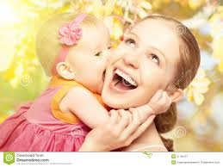
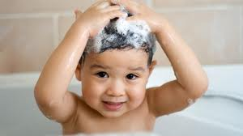
Vocabulary
1.Cheerful
Adj
Merry/glad.
2.Hygiene
Noun
To be clean and tidy.

Slide 20
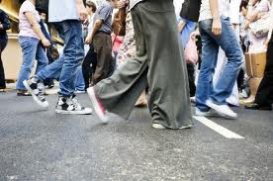
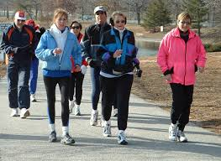
walking

Slide 21
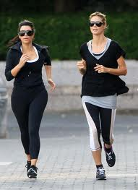
Jogging

Slide 22
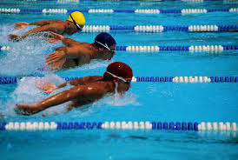
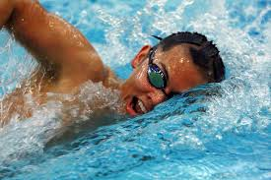
Swimming

Slide 23
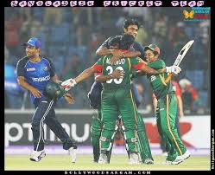
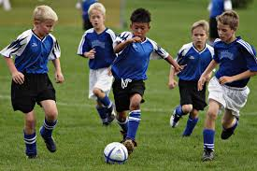
Playing Games

Slide 24
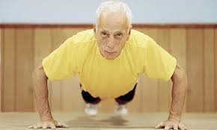
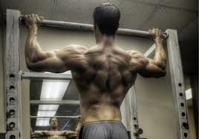
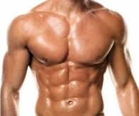
Physical Exercise keeps us fit for work.

Slide 25
Pair work
Discuss with your partner and write down the name of 3 indoors and 3 outdoors physical exercise.

Slide 26
Group Work
Discuss in your group and make 5 sentences about What types of physical exercise do you do?

Slide 27
Evaluation
1 What things are necessary for good health?
2 How many physical exercises are there?
3 Why do we need physical exercise?

Slide 28
HOME TASK
Write a paragraph in your own words about
Physical Exercise and its Importance .

Slide 29
